Slide 1
Chapter-1
Integration
Indefinite Integrals
Definite Integrals

Slide 2
1.1Indefinite Integrals

Slide 3
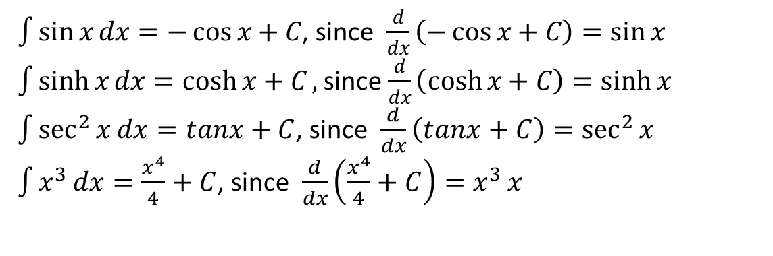
1.1.1 Definition of Indefinite Integrals
Indefinite integration may be regarded as the inverse operation to differentiation. This means that the derivative of an indefinite integral of a function is the function itself.
Given a function $f(x)$ and $F(x)$ is an anti-derivative of $f\left(x\right)$such that $F^{′}\left(x\right)=f(x)$. Then$F(x)$ is said to be indefinite integral or anti derivative of $f\left(x\right)$ ,which can be written as
Here, is called integral symbol, $f(x)$ is called integrand, $x$ is called integration variable and $C$ is called constant of integration.
Example 1.1.1
$\int{\sin{x}}dx=−\cos{x}+C$, since $\frac{d}{dx}\left(−\cos{x}+C\right)=\sin{x}$
$\int{\sinh{x}dx=\cosh{x+C},}$ since $\frac{d}{dx}\left(\cosh{x}+C\right)=\sinh{x}$
$\int{\sec^{2}{x}}dx=tanx+C$, since $\frac{d}{dx}\left(tanx+C\right)=\sec^{2}{x}$
$\int{x^{3}}dx=\frac{x^{4}}{4}+C$, since $\frac{d}{dx}\left(\frac{x^{4}}{4}+C\right)=x^{3}{x}$

Slide 4
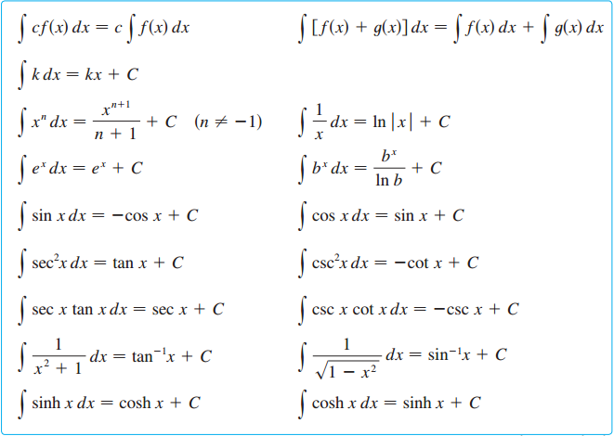
Integral properties and table of indefinite integrals
.

Slide 5
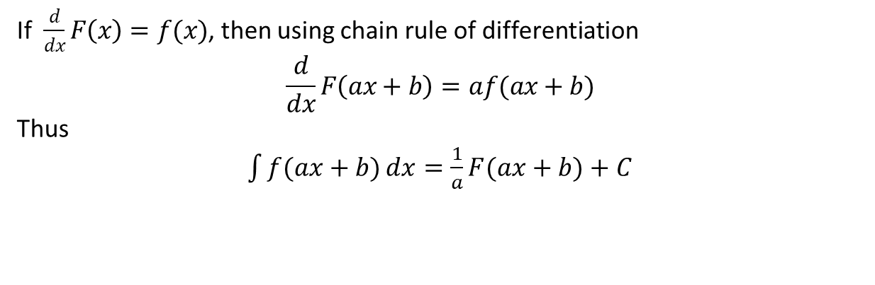
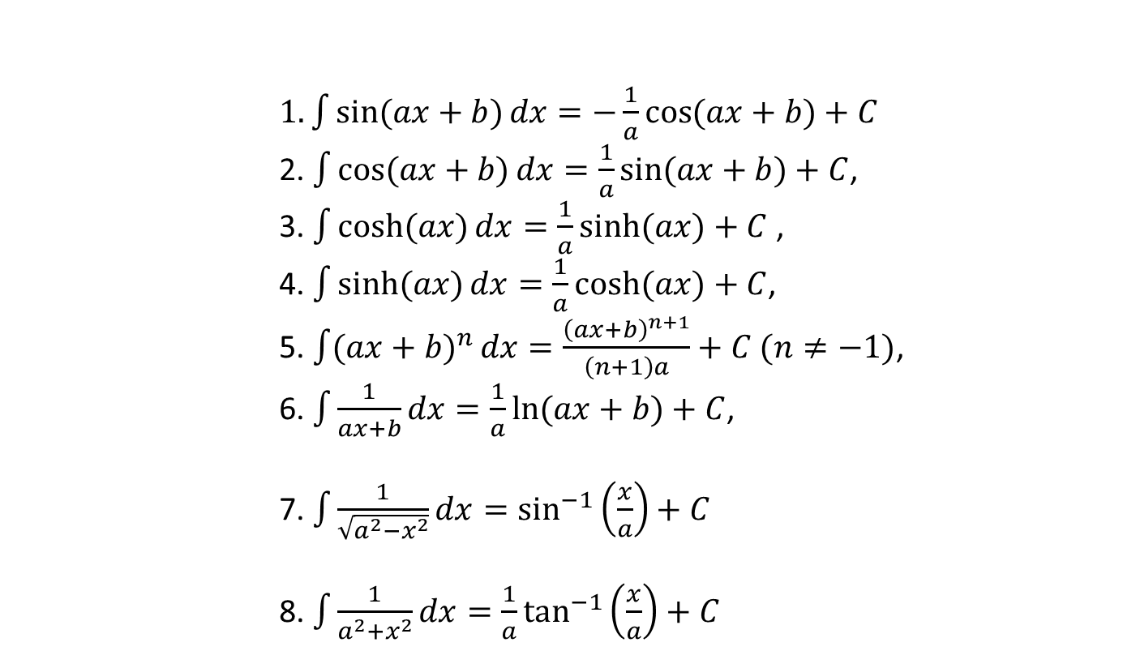
Useful Technique
If $\frac{d}{dx}F\left(x\right)=f(x)$, then using chain rule of differentiation
$$\frac{d}{dx}F\left(ax+b\right)=af(ax+b)$$
Thus
$1.\int{\sin{(ax+b)}dx}=−\frac{1}{a}\cos{(ax+b)}+C$
2. $\int{\cos{(ax+b)}dx}=\frac{1}{a}\sin{(ax+b)}+C$,
3. $\int{\cosh{(ax)}}dx=\frac{1}{a}\sinh{(ax)}+C$ ,
4. $\int{\sinh{(ax)}dx=\frac{1}{a}\cosh{(ax)}}+C$,
5. $\int{({ax+b)}^{n}}dx=\frac{{\left(ax+b\right)}^{n+1}}{\left(n+1\right)a}+C (n≠−1)$,
6. $\int{\frac{1}{ax+b}dx}=\frac{1}{a}\ln{(ax+b)}+C$,
7. $\int{\frac{1}{\sqrt{a^{2}−x^{2}}}dx}=\sin^{−1}\left(\frac{x}{a}\right)+C$
8. $\int{\frac{1}{a^{2}+x^{2}}dx}=\frac{1}{a}\tan^{−1}\left(\frac{x}{a}\right)+C$

Slide 6
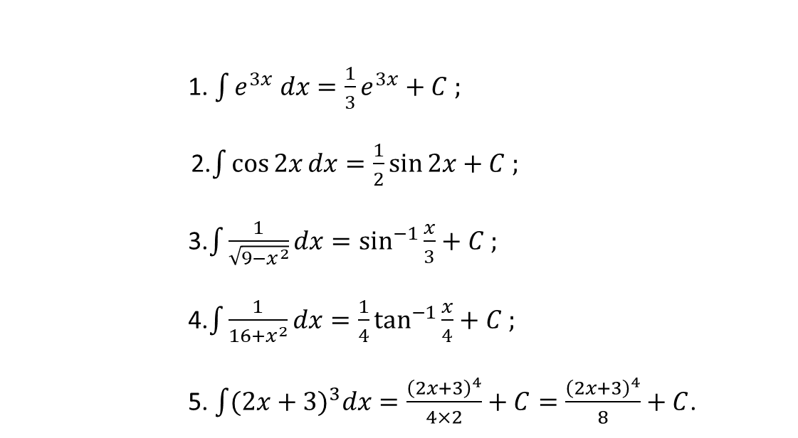
Example 1.1.2
1. $\int{e^{3x} dx}=\frac{1}{3}e^{3x}+C ;$
2.$\int{\cos{2x}}dx=\frac{1}{2}\sin{2x}+C ;$
3.$\int{\frac{1}{\sqrt{9−x^{2}}}dx}=\sin^{−1}{\frac{x}{3}}+C ;$
4.$\int{\frac{1}{16+x^{2}}dx}=\frac{1}{4}\tan^{−1}{\frac{x}{4}}+C ;$
5. $\int{(2x+{3)}^{3}dx=\frac{{\left(2x+3\right)}^{4}}{4×2}}+C=\frac{{\left(2x+3\right)}^{4}}{8}+C$.

Slide 7




Example set-1.1.1
1.
2.
3.

Slide 8


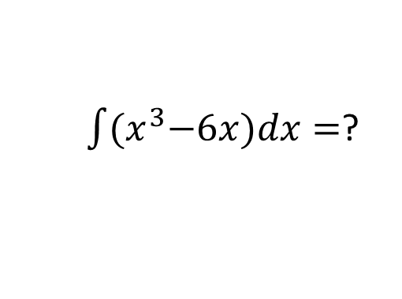
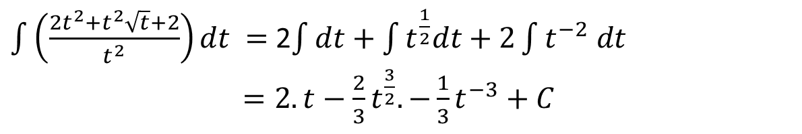
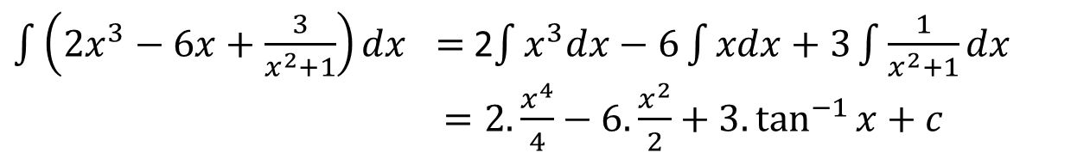
4.
$\int{\left({2x}^{3}−6x+\frac{3}{x^{2}+1}\right)dx} =$2$\int{x^{3}dx−6\int{xdx}+3\int{\frac{1}{x^{2}+1}dx}}$
$=2.\frac{x^{4}}{4}−6.\frac{x^{2}}{2}+3.\tan^{−1}{x+c}$
5.
$\int{\left(\frac{2t^{2}+t^{2}\sqrt{t}+2}{t^{2}}\right)dt} =$ 2$\int{dt+\int{t^{\frac{1}{2}}dt}+2\int{t^{−2} dt}}$
$=2.t−\frac{2}{3}t^{\frac{3}{2}}.−\frac{1}{3}t^{−3}+C$
6.
7.
$\int{{(x}^{3}−6x)dx}=$?

Slide 9
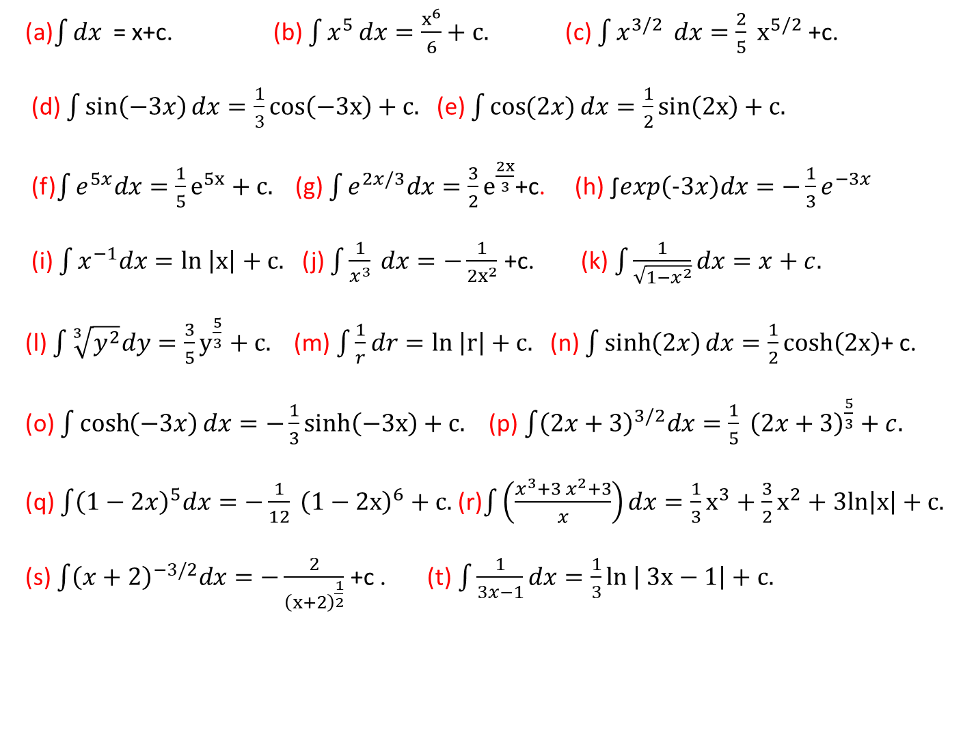
Exercise set-1.1.1
(a)$\int{dx}$ = x+c. (b) $\int{x^{5 }dx}=\frac{x^{6}}{6}+c.$ (c) $\int{x^{3/2 } dx}=\frac{2}{5} x^{5/2}$ +c.
(d) $\int{\sin\left(−3x\right)dx}=\frac{1}{3}cos\left(−3x\right)+c.$(e) $\int{\cos{(2x)}dx}=\frac{1}{2}sin\left(2x\right)+c.$
(f)$\int{e^{5x}dx}=\frac{1}{5}e^{5x}+c.$ (g) $\int{e^{2x/3}dx}=\frac{3}{2}e^{\frac{2x}{3}}$+c. (h) ∫$exp\left(−3x\right)dx=−\frac{1}{3}e^{−3x}$
(i) $\int{x^{−1}dx}=ln \left|x\right|+c.$ (j) $\int{\frac{1}{x^{3}}} dx=−\frac{1}{2x^{2}}$ +c. (k) $\int{\frac{1}{\sqrt{1−x^{2}}}dx=x+c.}$
(l) $\int{\sqrt[3]{y^{2}}dy}=\frac{3}{5}y^{\frac{5}{3}}+c.$ (m) $\int{\frac{1}{r}dr}=ln \left|r\right|+c.$ (n) $\int{\sinh\left(2x\right)dx}=\frac{1}{2}cosh\left(2x\right)$+ c.
(o) $\int{\cosh\left(−3x\right)dx}=−\frac{1}{3}sinh\left(−3x\right)+c.$ (p)$\int{{\left(2x+3\right)}^{3/2}dx=\frac{1}{5} {\left(2x+3\right)}^{\frac{5}{3}}+c.}$
(q) $\int{{\left(1−2x\right)}^{5}dx}=−\frac{1}{12} {\left(1−2x\right)}^{6}+c.$ (r)$\int{\left(\frac{x^{3}+3 x^{2}+3}{x}\right)dx}=\frac{1}{3}x^{3}+\frac{3}{2}x^{2}+3ln\left|x\right|+c.$
(s) $\int{{\left(x+2\right)}^{−3/2}dx}=−\frac{2}{{\left(x+2\right)}^{\frac{1}{2}}}$ +c . (t)$\int{\frac{1}{3x−1}dx}=\frac{1}{3}ln \left| 3x−1\right|+c.$

Slide 10
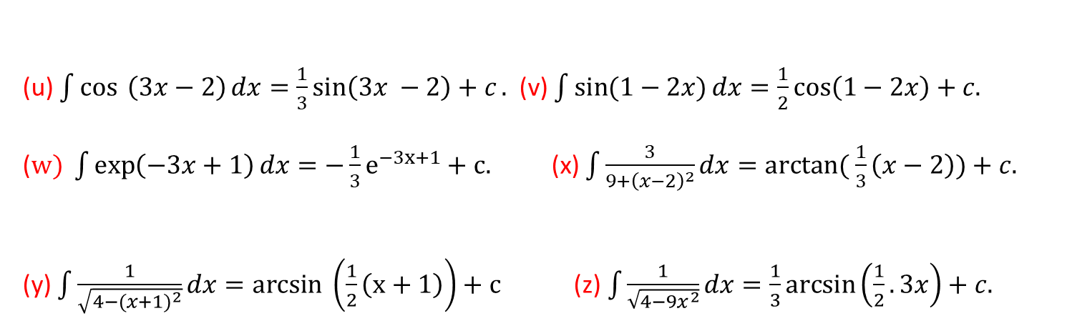
(u) $\int{\cos{ \left(3x−2\right)}dx=\frac{1}{3}\sin\left(3x −2\right)+c}.$ (v) $\int{\sin{(1−2x)}dx}=\frac{1}{2}\cos\left(1−2x\right)+c.$
($w) \int{\exp\left(−3x+1\right)dx}=−\frac{1}{3}e^{−3x+1}+c.$ (x) $\int{\frac{3}{9+{\left(x−2\right)}^{2}}dx}=arctan⁡( \frac{1}{3}\left(x−2\right))+c.$
(y) $\int{\frac{1}{\sqrt{4−({x+1)}^{2}}}dx}=arcsin \left(\frac{1}{2}\left(x+1\right)\right)+c$ (z) $\int{\frac{1}{\sqrt{4−9x^{2}}}dx=\frac{1}{3}\arcsin\left(\frac{1}{2}.3x\right)+c.}$

Slide 11
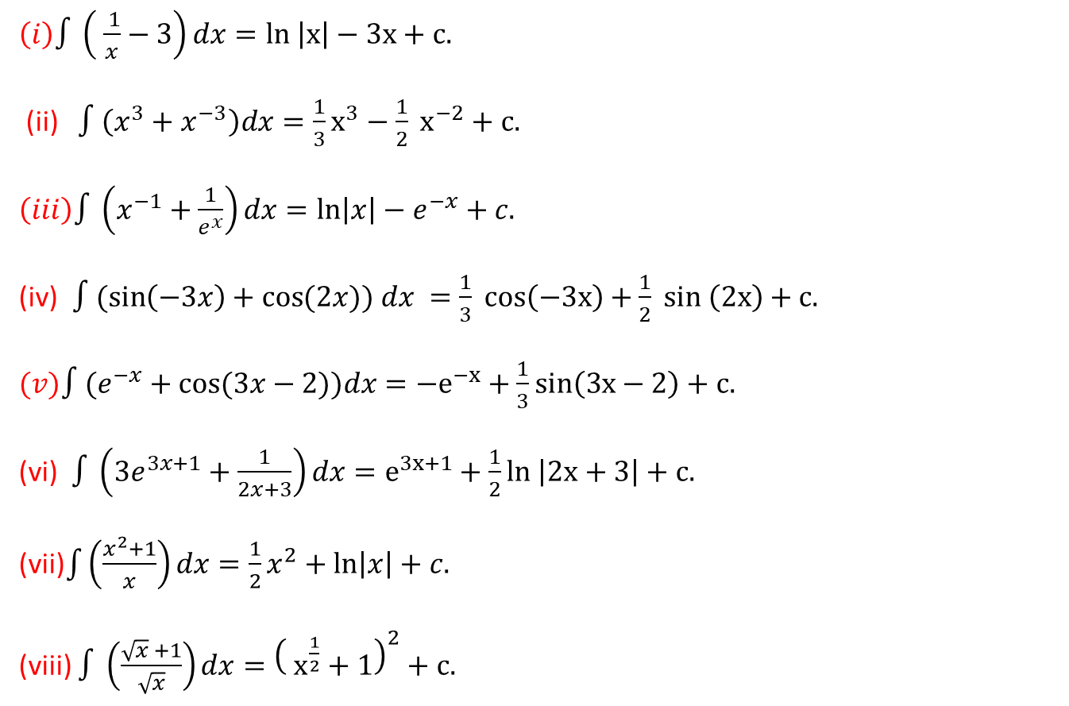
Exercise set-1.1.2
$\left(i\right)∫\left( \frac{ 1}{x}−3\right)dx=ln \left|x\right|−3x+c.$
(ii) $∫\left(x^{3}+x^{−3}\right)dx=\frac{1}{3}x^{3}−\frac{1}{2} x^{−2}+c.$
$\left(iii\right)∫\left(x^{−1}+\frac{1}{e^{x}}\right)dx=\ln\left|x\right|−e^{−x}+c.$
(iv)$∫(\sin\left(−3x\right)+\cos{(2x)) dx }=\frac{1}{3} cos\left(−3x\right)+\frac{1}{2} sin \left(2x\right)+c.$
$(v)∫(e^{−x}+\cos{(3x−2))dx}=−e^{−x}+\frac{1}{3}sin\left(3x−2\right)+c.$
(vi) $∫\left(3e^{3x+1}+\frac{1}{2x+3}\right)dx=e^{3x+1}+\frac{1}{2}ln \left|2x+3\right|+c.$
(vii)$\int{\left(\frac{x^{2}+1}{x}\right)}dx=\frac{1}{2}x^{2}+\ln\left|x\right|+c.$
(viii) $∫\left(\frac{\sqrt{x} +1}{\sqrt{x}}\right)dx={\left( x^{\frac{1}{2}}+1\right)}^{2}+c.$

Slide 12
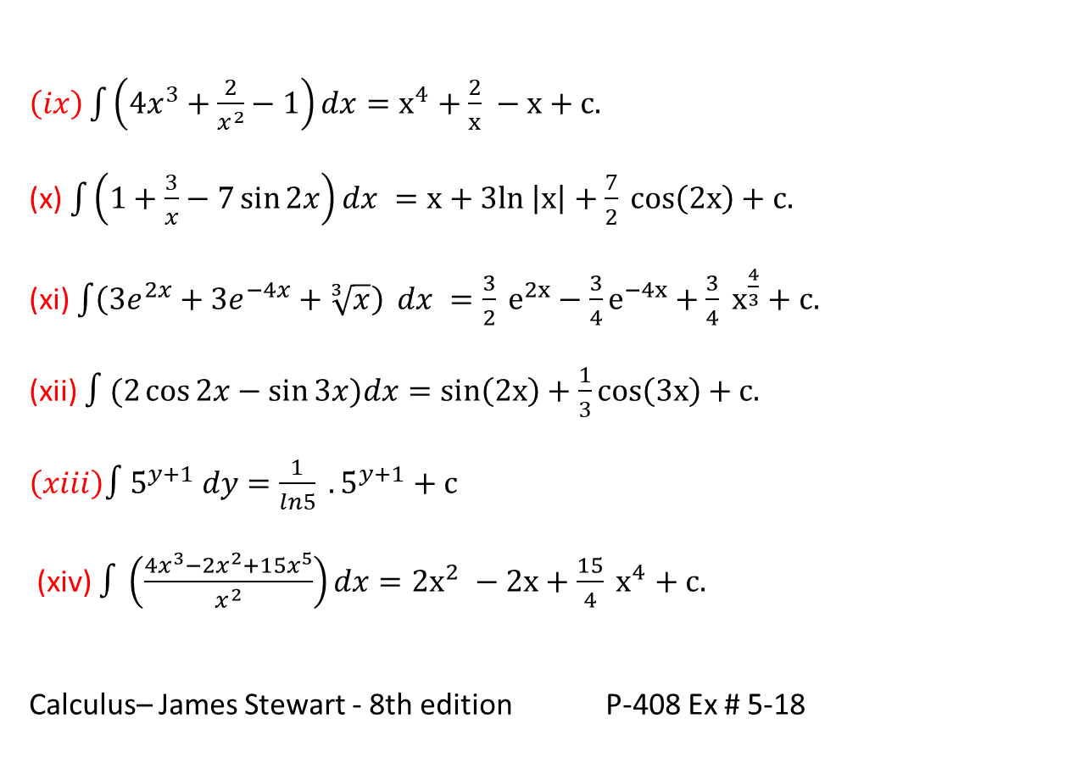
$\left(ix\right)\int{\left(4x^{3}+\frac{2}{x^{2}}−1\right)}dx=x^{4}+\frac{2}{x} −x+c.$
(x) $\int{\left(1+\frac{3}{x}−7\sin{2x}\right)dx }=x+3ln \left|x\right|+\frac{7}{2} cos\left(2x\right)+c.$
(xi) $\int{\left(3e^{2x}+3e^{−4x}+\sqrt[3]{x}\right)} dx =\frac{3}{2} e^{2x}−\frac{3}{4}e^{−4x}+\frac{3}{4} x^{\frac{4}{3}}+c.$
(xii) $∫(2\cos{2x−\sin{3x)dx}}=sin\left(2x\right)+\frac{1}{3}cos\left(3x\right)+c.$
$\left(xiii\right)∫5^{y+1} dy=\frac{1}{ln5} . 5^{y+1}+c$
(xiv) $∫\left(\frac{4x^{3}−2x^{2}+15x^{5}}{x^{2}}\right)dx=2x^{2} −2x+\frac{15}{4} x^{4}+c.$
Calculus– James Stewart - 8th edition P-408 Ex # 5-18

Slide 13
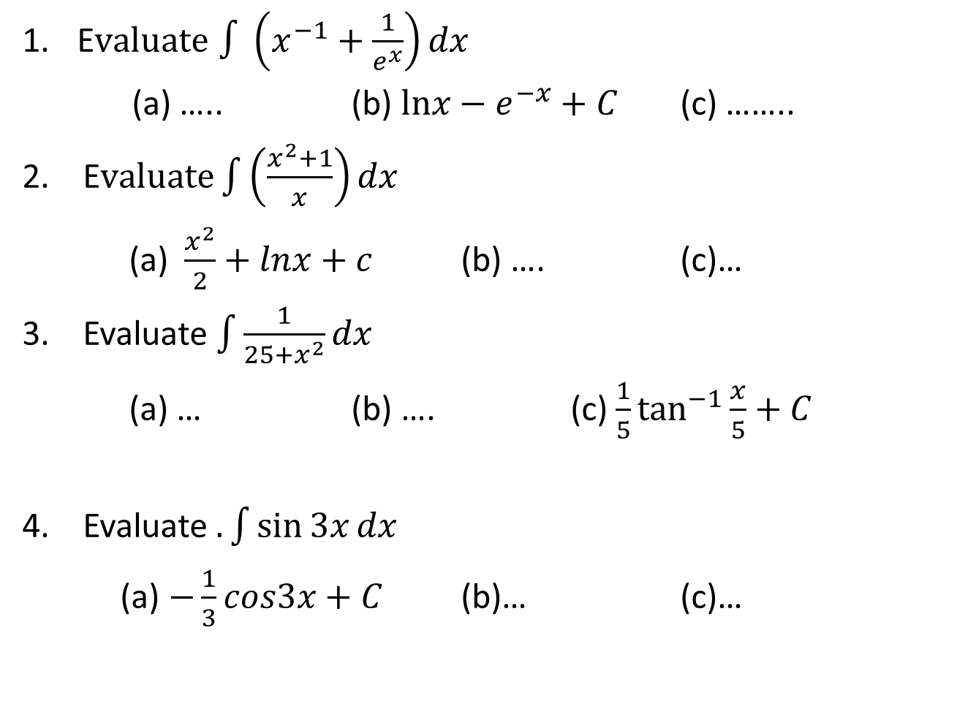
Sample MCQ
E$valuate$ $∫\left(x^{−1}+\frac{1}{e^{x}}\right)dx$
(a) ….. (b) $lnx−e^{−x}+C$ (c) ……..
2. $\text{E}valuate\int{\left(\frac{x^{2}+1}{x}\right)}dx$
(a) $\frac{x^{2}}{2}+lnx+c$ (b) …. (c)…
3. Evaluate $\int{\frac{1}{25+x^{2}}dx}$
(a) … (b) …. (c) $\frac{1}{5}\tan^{−1}{\frac{x}{5}}+C$
4. Evaluate $.\int{\sin{3x}}dx$
(a) $−\frac{1}{3}cos3x+C$ (b)… (c)…

Slide 14

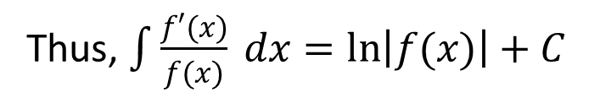


1.1.2 Integration by Substitution
If $u=g(x)$ is a differentiable function whose range is an interval $I$ and $f(x)$ is continuous on $I$ then
$$∫f\left(g\left(x\right)\right)g^{′}\left(x\right)dx=∫f(u)du$$
Where If $u=g(x)$ then $du=g^{′}\left(x\right)dx$
An integral of the form$\int{\frac{f′(x)}{f(x)} dx}$
Thus, $\int{\frac{f′(x)}{f(x)} dx=\ln\left|f(x)\right|+C}$

Slide 15
Example set 1.1.2
1.
2.

Slide 16
3.
4.
5.

Slide 17
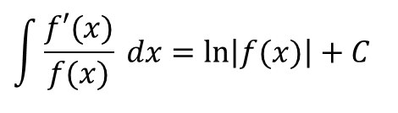
6.
$$\int{\frac{f′(x)}{f(x)} dx=\ln\left|f(x)\right|+C}$$
7.
8.
9.
10.

Slide 18
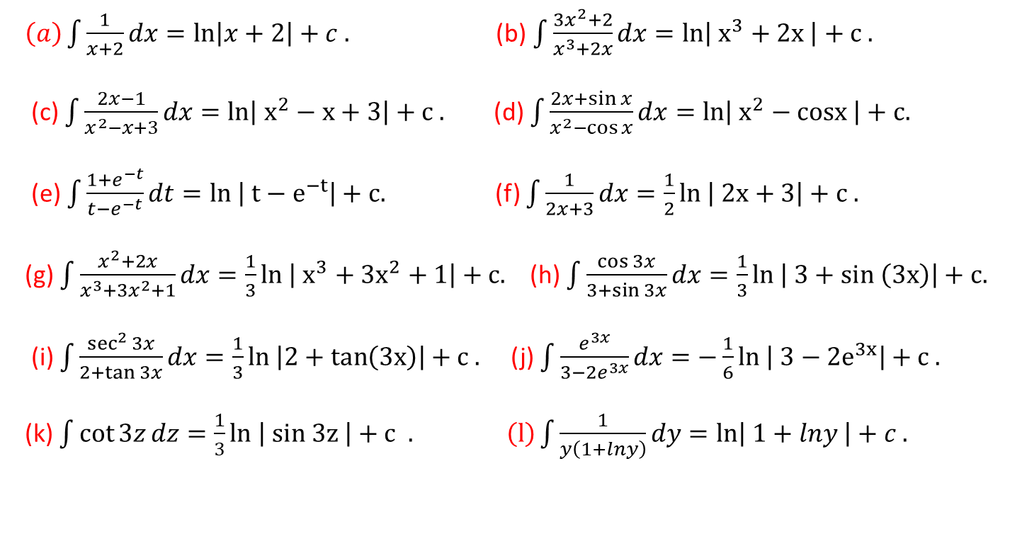
Exercise set-1.1.3
.
$\left(a\right)\int{\frac{1}{x+2}dx}=\ln\left|x+2\right|+c .$ (b) $\int{\frac{3x^{2}+2}{x^{3}+2x}dx}=ln\left| x^{3}+2x \right|+c .$
(c) $\int{\frac{2x−1}{x^{2}−x+3}dx}=ln\left| x^{2}−x+3\right|+c .$ (d) $\int{\frac{2x+\sin{x}}{x^{2}−\cos{x}}dx}=ln\left| x^{2}−cosx \right|+c.$
(e) $\int{\frac{1+e^{−t}}{t−e^{−t}}dt}=ln \left| t−e^{−t}\right|+c.$ (f) $\int{\frac{1}{2x+3}dx}=\frac{1}{2}ln \left| 2x+3\right|+c .$
(g) $\int{\frac{x^{2}+2x}{x^{3}+3x^{2}+1}dx}=\frac{1}{3}ln \left| x^{3}+3x^{2}+1\right|+c.$ (h) $\int{\frac{\cos{3x}}{3+\sin{3x}}dx}=\frac{1}{3}ln \left| 3+sin \left(3x\right)\right|+c.$
(i) $\int{\frac{\sec^{2}{3x}}{2+\tan{3x}}dx}=\frac{1}{3}ln \left|2+tan\left(3x\right)\right|+c .$ (j) $\int{\frac{e^{3x}}{3−2e^{3x}}dx}=−\frac{1}{6}ln \left| 3−2e^{3x}\right|+c .$
(k) $\int{\cot{3z}}dz=\frac{1}{3}ln \left| sin 3z \right|+c . \left(l\right)\int{\frac{1}{y\left(1+lny\right)}dy=\ln\left| 1+lny \right|+c .}$

Slide 19
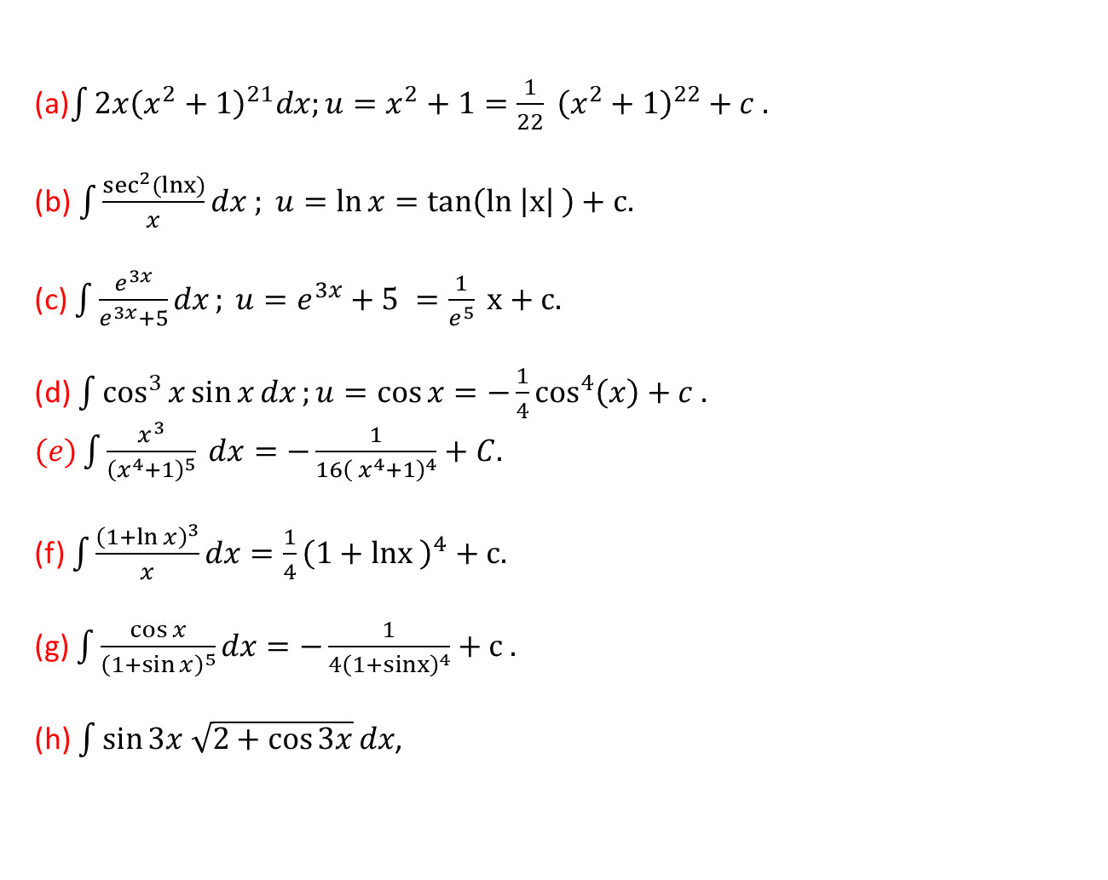
Exercise set-1.1.4
(a)$\int{2x{\left(x^{2}+1\right)}^{21}dx;u=x^{2}+1=\frac{1}{22} {\left(x^{2}+1\right)}^{22}+c .}$
(b)$\int{\frac{\sec^{2}(lnx)}{x}}dx ; u=\ln{x}=tan\left(ln \left|x\right| \right)+c.$
(c) $\int{\frac{e^{3x}}{e^{3x}+5}dx}; u=e^{3x}+5 =\frac{1}{e^{5}} x+c.$
(d) $\int{\cos^{3}{x}\sin{x}dx};u=\cos{x=−\frac{1}{4}\cos^{4}\left(x\right)+c .}$
$(e)\int{\frac{x^{3}}{{\left(x^{4}+1\right)}^{5}} dx=−\frac{1}{16{\left( x^{4}+1\right)}^{4}}+C.}$
(f) $\int{\frac{{\left(1+\ln{x}\right)}^{3}}{x}dx}=\frac{1}{4}{\left(1+lnx \right)}^{4}+c.$
(g) $\int{\frac{\cos{x}}{{\left(1+\sin{x}\right)}^{5}}dx}=−\frac{1}{4{\left(1+sinx\right)}^{4}}+c .$
(h) $\int{\sin{3x \sqrt{2+\cos{3x}}}dx}$,
.

Slide 20
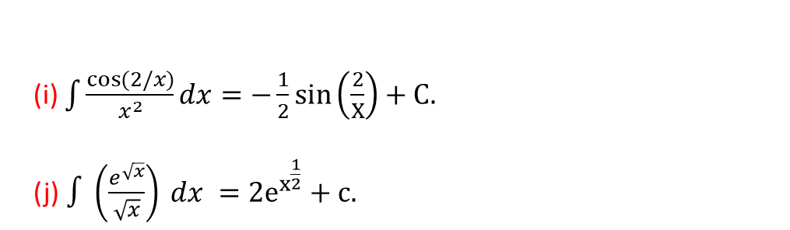
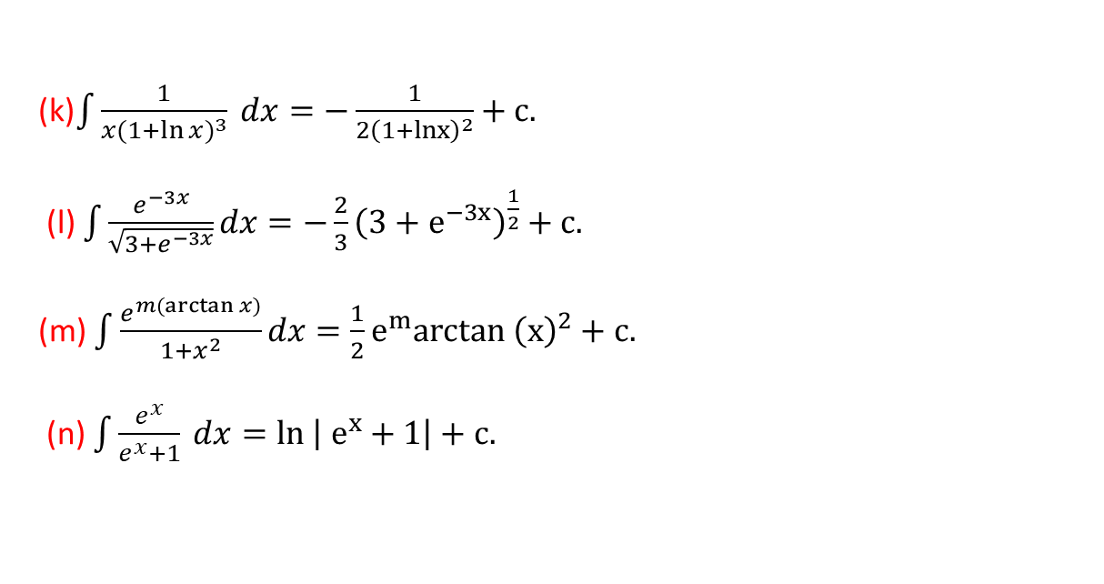

(i) $\int{\frac{\cos{(2/x)}}{x^{2}}dx}=−\frac{1}{2}sin\left(\frac{2}{X}\right)+C.$
(j)$∫\left(\frac{e^{\sqrt{x}}}{\sqrt{x}}\right) dx =2e^{x^{\frac{1}{2}}}+c.$
(k)$\int{\frac{1}{x{(1+\ln{x})}^{3}} dx}=−\frac{1}{2{\left(1+lnx\right)}^{2}}+c.$
(l) $\int{\frac{e^{−3x}}{\sqrt{3+e^{−3x}}}dx}=−\frac{2}{3}{\left(3+e^{−3x}\right)}^{\frac{1}{2}}+c.$
(m) $\int{\frac{e^{m(\arctan{x)}}}{1+x^{2}}}dx=\frac{1}{2}e^{m}arctan {\left(x\right)}^{2}+c.$
(n) $\int{\frac{e^{x}}{e^{x}+1} dx}=ln \left| e^{x}+1\right|+c.$
$$\left(o\right)\int{4\tan^{3}{x\sec^{2}{x dx ;u=tanx}}}=\tan^{4}\left(x\right)+c.$$
Calculus– James Stewart - 8th edition
P-418 Ex # 7 - 13, 15, 18, 20, 21, 27, 31, 32, 43.

Slide 21

Sample MCQ
E$valuate\int{\frac{e^{x}}{e^{x}+1} dx}$
(a) ….. (b) $\ln\left(1+e^{x}\right)+C$ (c) ……..
$\text{E}valuate\int{\frac{x^{2}+2x}{x^{3}+3x^{2}+1}dx}\text{,}$
(a) $⁡3ln⁡(x^{3}+3x^{2}+1)+c$ (b) …. (c)…
3. Evaluate$\int{\frac{1}{x{(1+\ln{x})}^{3}} dx}$,
(a) … (b) …. (c) $−\frac{1}{2}{\left(1+lnx\right)}^{−2}+C$

Slide 22
1.2 Definite Integrals

Slide 23

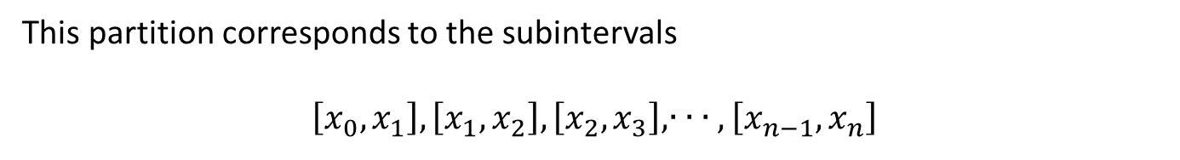
1.2.1 Riemann and Trapezoidal Sum
Consider a function $f(x)$ which is defined (i.e. bounded) over the closed interval$[a, b]$.
Consider a partition P of $\left[a, b\right]$ into $n$ subintervals by the points
This partition corresponds to the subintervals
$$\left[x_{0},x_{1}\right], \left[x_{1},x_{2}\right], \left[x_{2},x_{3}\right], ∙ ∙ ∙ ,\left[x_{n−1},x_{n}\right]$$

Slide 24
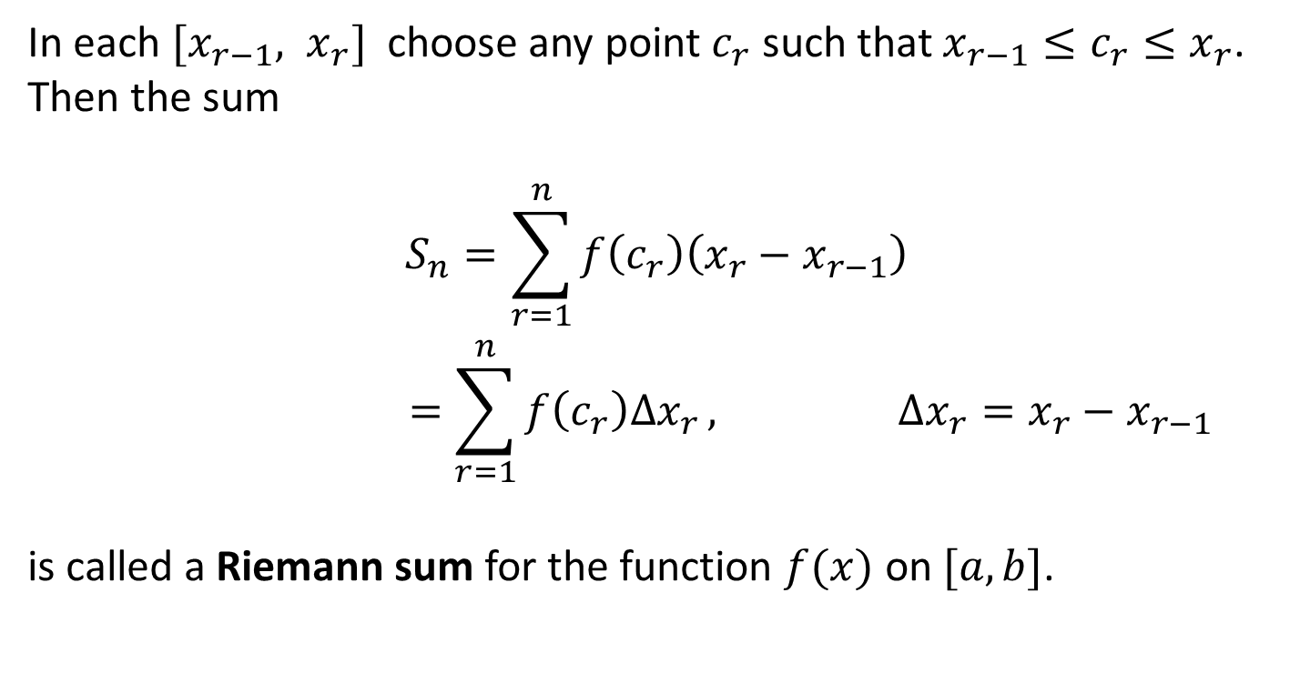
In each $[x_{r−1}, x_{r}]$ choose any point $c_{r}$ such that $x_{r−1}≤c_{r}≤x_{r}$. Then the sum
$$\begin{aligned}S_{n}=\sum_{r=1}^{n}{f\left(c_{r}\right)\left(x_{r}−x_{r−1}\right)} \\ =\sum_{r=1}^{n}{f\left(c_{r}\right)∆x_{r }, ∆x_{r}=x_{r}−x_{r−1}}\end{aligned}$$
is called a Riemann sum for the function $f(x)$ on $[a, b]$.

Slide 25
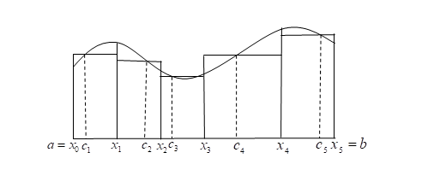
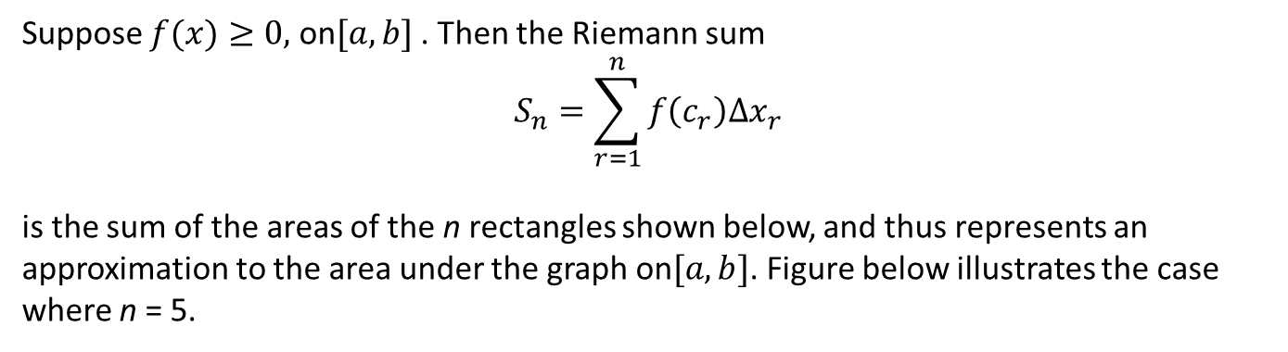
Suppose $f(x)≥0,$ on$[a,b]$ . Then the Riemann sum
$$\begin{aligned}S_{n}=\sum_{r=1}^{n}{f\left(c_{r}\right){∆x}_{r}} \\ \end{aligned}$$
is the sum of the areas of the n rectangles shown below, and thus represents an approximation to the area under the graph on$[a, b]$. Figure below illustrates the case where n = 5.

Slide 26
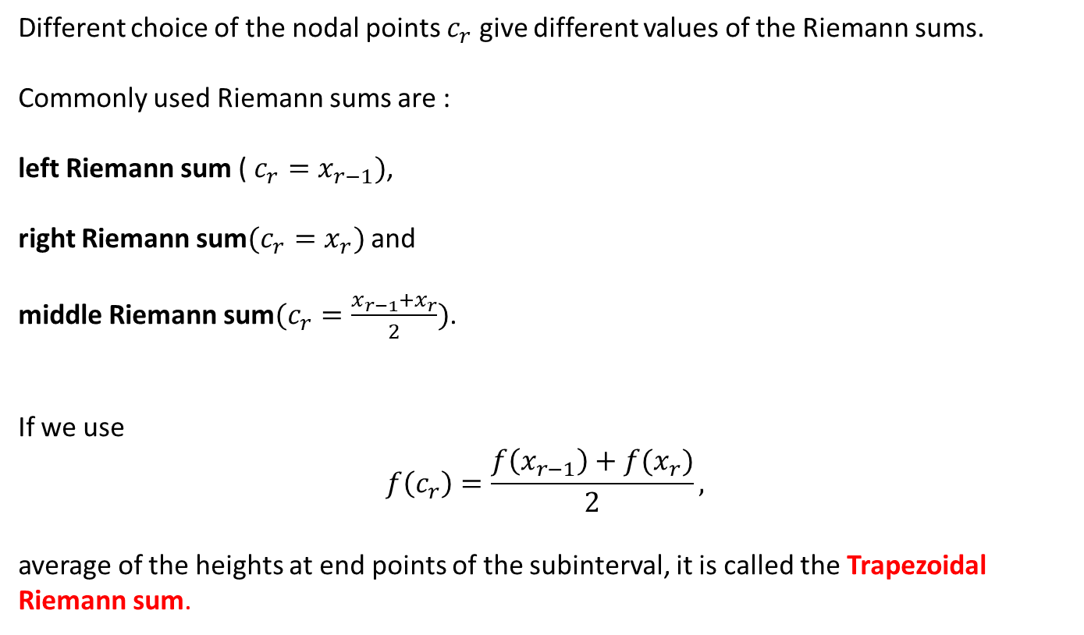
Different choice of the nodal points $c_{r}$ give different values of the Riemann sums.
Commonly used Riemann sums are :
left Riemann sum ( $c_{r}=x_{r−1})$,
right Riemann sum$(c_{r}=x_{r})$ and
middle Riemann sum$(c_{r}=\frac{x_{r−1}+x_{r}}{2})$.
If we use
$$f\left(c_{r}\right)=\frac{f\left(x_{r−1}\right)+f(x_{r})}{2},$$
average of the heights at end points of the subinterval, it is called the Trapezoidal Riemann sum.

Slide 27
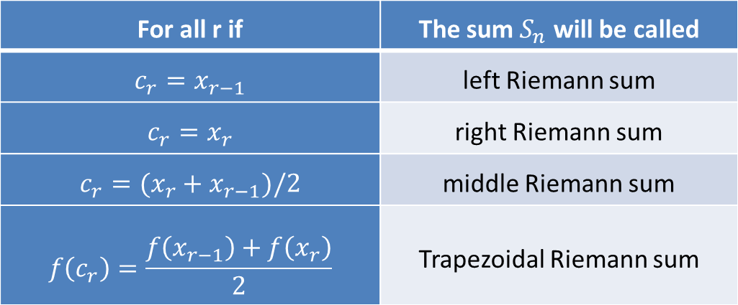
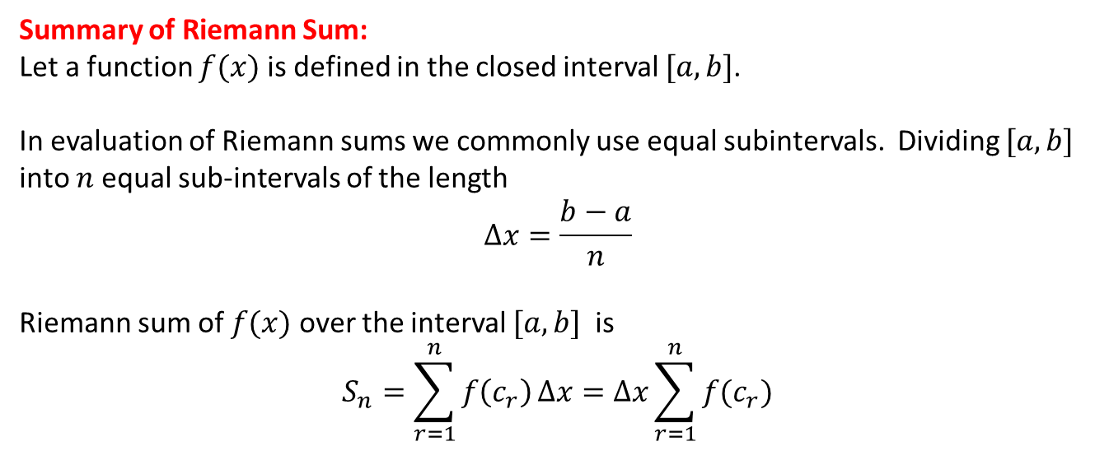
Summary of Riemann Sum:
Let a function $f(x)$ is defined in the closed interval $[a,b]$.
In evaluation of Riemann sums we commonly use equal subintervals. Dividing $[a,b]$ into $n$ equal sub-intervals of the length
$$∆x=\frac{b−a}{n}$$
Riemann sum of $f(x)$ over the interval $[a,b]$ is
$$S_{n}=\sum_{r=1}^{n}{f\left(c_{r}\right)}∆x=∆x\sum_{r=1}^{n}{f(c_{r})}$$
For all r if | The sum $S_{n}$ will be called
$$c_{r}=x_{r−1}$$ | left Riemann sum
$$c_{r}=x_{r}$$ | right Riemann sum
$$c_{r}=(x_{r}+x_{r−1})/2$$ | middle Riemann sum
$$f\left(c_{r}\right)=\frac{f\left(x_{r−1}\right)+f\left(x_{r}\right)}{2}$$ | Trapezoidal Riemann sum

Slide 28
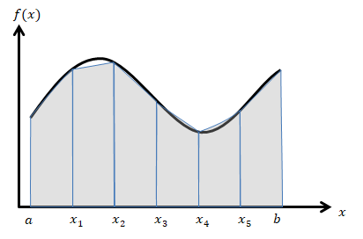
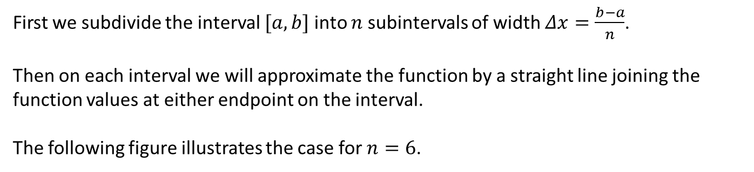
1.2.2 Numerical Integration (The Trapezoidal Rule)
First we subdivide the interval $[a,b]$ into $n$ subintervals of width $Δx=\frac{b−a}{n}$.
Then on each interval we will approximate the function by a straight line joining the function values at either endpoint on the interval.
The following figure illustrates the case for $n=6$.
Each of these shaded objects is a trapezoid (hence the rule’s name) and as we can see some of them do a very good approximation to the actual area under the corresponding segment of the curve.

Slide 29
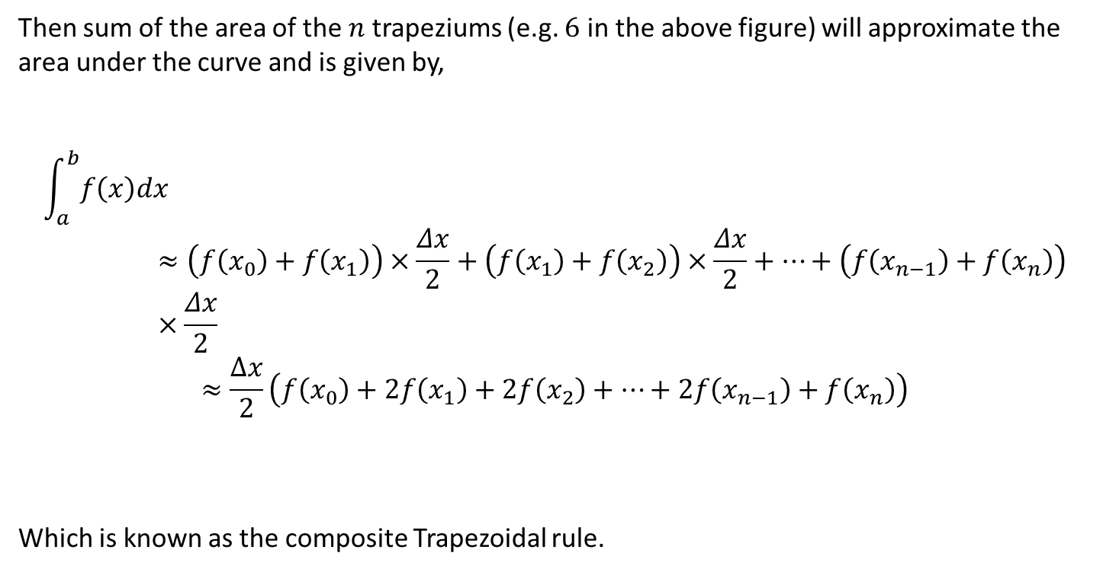
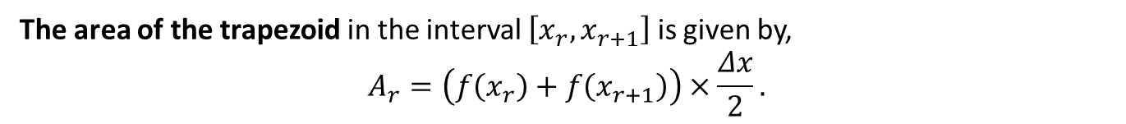
The area of the trapezoid in the interval $\left[x_{r},x_{r+1}\right]$ is given by,
$$A_{r}=\left(f\left(x_{r}\right)+f\left(x_{r+1}\right)\right)×\frac{Δx}{2}.$$
Then sum of the area of the $n$ trapeziums (e.g. $6$ in the above figure) will approximate the area under the curve and is given by,
$$\int_{a}^{b}{f\left(x\right)dx}≈\left(f\left(x_{0}\right)+f\left(x_{1}\right)\right)×\frac{Δx}{2}+\left(f\left(x_{1}\right)+f\left(x_{2}\right)\right)×\frac{Δx}{2}+…+\left(f\left(x_{n−1}\right)+f\left(x_{n}\right)\right)×\frac{Δx}{2}$$
$$≈\frac{∆x}{2}\left(f\left(x_{0}\right)+2f\left(x_{1}\right)+2f\left(x_{2}\right)+…+2f\left(x_{n−1}\right)+f\left(x_{n}\right)\right)$$
Which is known as the composite Trapezoidal rule.

Slide 30
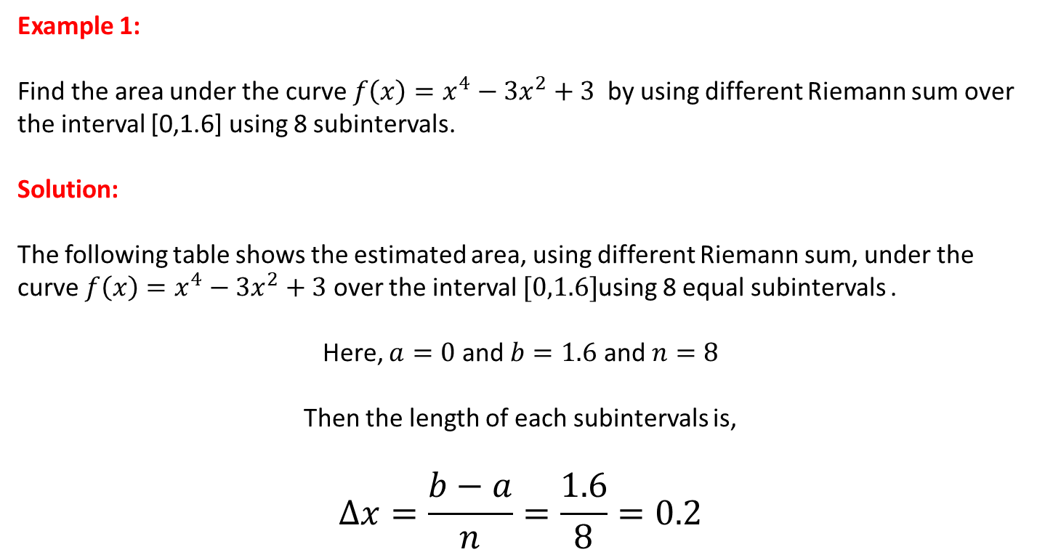
Example set 1.2.1
Example 1:
Find the area under the curve ${f\left(x\right)=x}^{4}−3x^{2}+3$ by using different Riemann sum over the interval [0,1.6] using 8 subintervals.
Solution:
The following table shows the estimated area, using different Riemann sum, under the curve ${f\left(x\right)=x}^{4}−3x^{2}+3$ over the interval $[0,1.6]$using 8 equal subintervals .
Here, $a=0$ and $b=1.6$ and $n=8$
Then the length of each subintervals is,
$$Δx=\frac{b−a}{n}=\frac{1.6}{8}=0.2$$

Slide 31
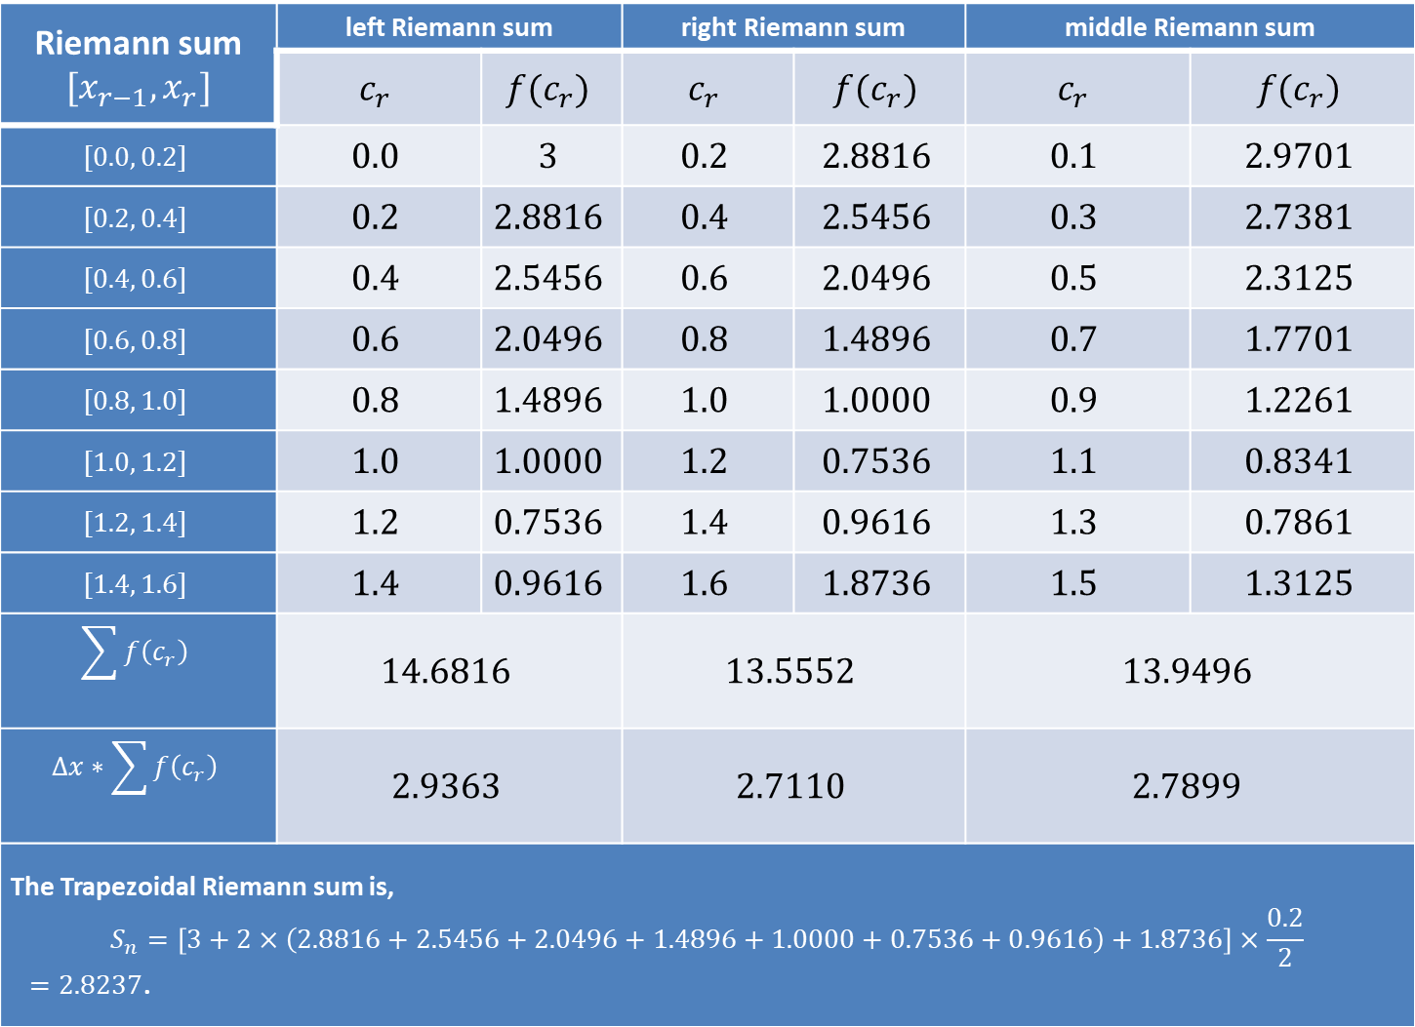
Riemann sum $$[x_{r−1},x_{r}]$$ | left Riemann sum |  | right Riemann sum |  | middle Riemann sum
 | $$c_{r}$$ | $$f(c_{r})$$ | $$c_{r}$$ | $$f(c_{r})$$ | $$c_{r}$$ | $$f(c_{r})$$
$$[0.0, 0.2]$$ | $$0.0$$ | $$3$$ | $$0.2$$ | $$2.8816$$ | $$0.1$$ | $$2.9701$$
$$[0.2, 0.4]$$ | $$0.2$$ | $$2.8816$$ | $$0.4$$ | $$2.5456$$ | $$0.3$$ | $$2.7381$$
$$[0.4, 0.6]$$ | $$0.4$$ | $$2.5456$$ | $$0.6$$ | $$2.0496$$ | $$0.5$$ | $$2.3125$$
$$[0.6, 0.8]$$ | $$0.6$$ | $$2.0496$$ | $$0.8$$ | $$1.4896$$ | $$0.7$$ | $$1.7701$$
$$[0.8, 1.0]$$ | $$0.8$$ | $$1.4896$$ | $$1.0$$ | $$1.0000$$ | $$0.9$$ | $$1.2261$$
$$[1.0, 1.2]$$ | $$1.0$$ | $$1.0000$$ | $$1.2$$ | $$0.7536$$ | $$1.1$$ | $$0.8341$$
$$[1.2, 1.4]$$ | $$1.2$$ | $$0.7536$$ | $$1.4$$ | $$0.9616$$ | $$1.3$$ | $$0.7861$$
$$[1.4, 1.6]$$ | $$1.4$$ | $$0.9616$$ | $$1.6$$ | $$1.8736$$ | $$1.5$$ | $$1.3125$$
$$\sum{f\left(c_{r}\right)}$$ | $$14.6816$$ |  | $$13.5552$$ |  | $$13.9496$$
$$Δx∗\sum{f\left(c_{r}\right)}$$ | $$2.9363$$ |  | $$2.7110$$ |  | $$2.7899$$
The Trapezoidal Riemann sum is, $$S_{n}=\left[3+2×\left(2.8816+2.5456+2.0496+1.4896+1.0000+0.7536+0.9616\right)+1.8736\right]×\frac{0.2}{2}$$ $=2.8237$.

Slide 32
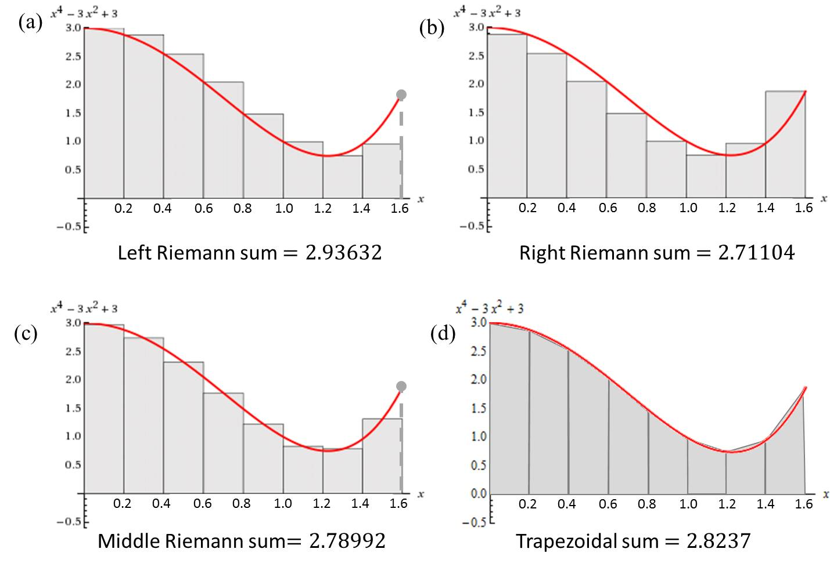
The following figures show the geometrical interpretation of the above Riemann sums,
Note that the exact value of the area is $2.80115$ which is calculated using the integration will be considered later.

Slide 33

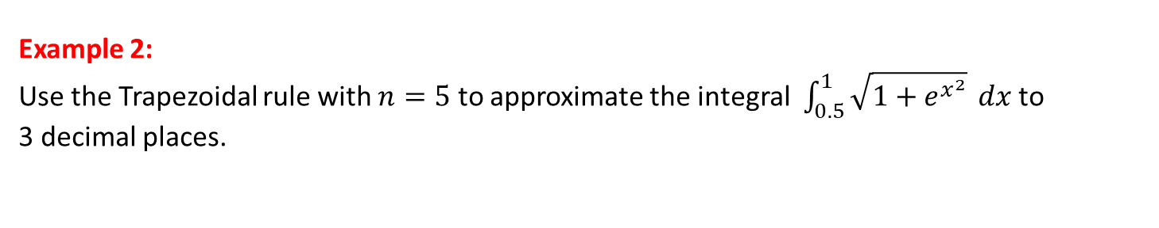
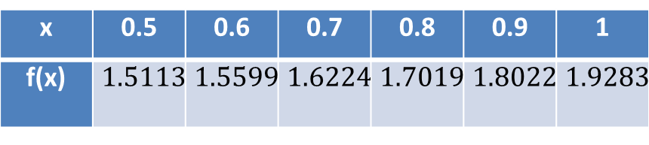
Example 2:
Use the Trapezoidal rule with $n=5$ to approximate the integral $\int_{0.5}^{1}{\sqrt{1+e^{x^{2}}}} dx$ to 3 decimal places.
Solution:
Here $a=0.5$, $b=1$ and $n=5$. So $∆x=\frac{1−0.5}{5}=0.1$and $f\left(x\right)=\sqrt{1+e^{x^{2}}}$.
Hence,
Using the Trapezoidal rule, we have
$$\int_{0.5}^{1}{\sqrt{1+e^{x^{2}}}} dx≈\frac{0.1}{2}[1.5113+2\left(1.5599\right)+2\left(1.6224\right)$$
$+2(1.7019)+2\left(1.8022\right)+1.9283]$
=$0.8406≈0.841$
x | 0.5 | 0.6 | 0.7 | 0.8 | 0.9 | 1
f(x) | $$1.5113$$ | $$1.5599$$ | $$1.6224$$ | $$1.7019$$ | $$1.8022$$ | $$1.9283$$

Slide 34
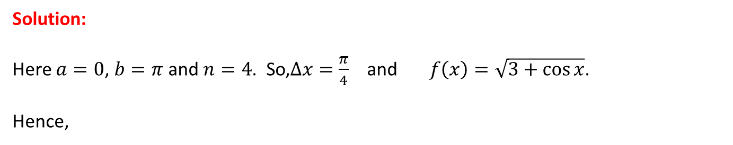
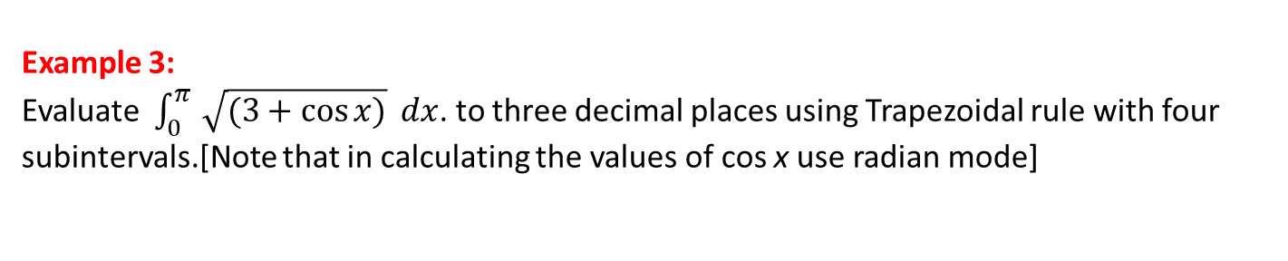
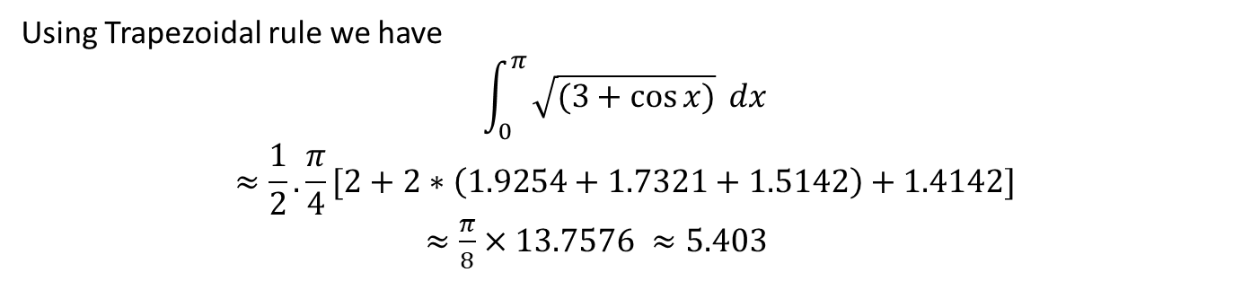
Example 3:
Evaluate $\int_{0}^{π }{\sqrt{(3+\cos{x)}}} dx$. to three decimal places using Trapezoidal rule with four subintervals.[Note that in calculating the values of cos x use radian mode]
Solution:
Here $a=0$, $b=π$ and $n=4$. So,$∆x=\frac{π}{4}$ and $f\left(x\right)=\sqrt{3+\cos{x}}$.
Hence,
x | 0 | π/4 | π/2 | 3π/4 | π
f(x) | 2.0000 | 1.9254 | 1.7321 | 1.5142 | 1.4142
Using Trapezoidal rule we have
$$\int_{0}^{π }{\sqrt{(3+\cos{x)}}} dx$$
$$≈\frac{1}{2}.\frac{π}{4}[2+2∗\left(1.9254+1.7321+1.5142\right)+1.4142]$$
$≈\frac{π}{8}×13.7576 ≈5.403$

Slide 35
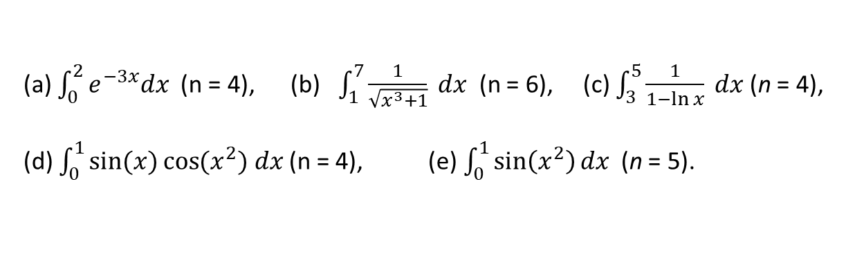
Exercise set 1.2.1
1.
Estimate the value the following integrals to 3 decimal places using ‘n’ subintervals of equal length using (i) left Riemann sum, (ii) right Riemann sum, (iii) middle Riemann sum and (iv) Trapezoidal rule.
(a) $\int_{0}^{2}{e^{−3x}dx }$(n = 4), (b) $\int_{1}^{7}{\frac{1}{\sqrt{x^{3}+1}} dx }$(n = 6), (c) $\int_{3}^{5}{\frac{1}{1−\ln{x}} dx }$(n = 4),
(d) $\int_{0}^{1}{\sin{(x)}\cos{{(x}^{2}) dx}}$ (n = 4), (e) $\int_{0}^{1}{\sin\left(x^{2}\right)dx}$ (n = 5).
2.
Calculus– James Stewart - 8th edition
P- 388 Ex # 1, 3, 7, 9
P- 524 Ex # 7, 8, 9 (n= 4, 6) LRS, RRS, MRS, TR

Slide 36
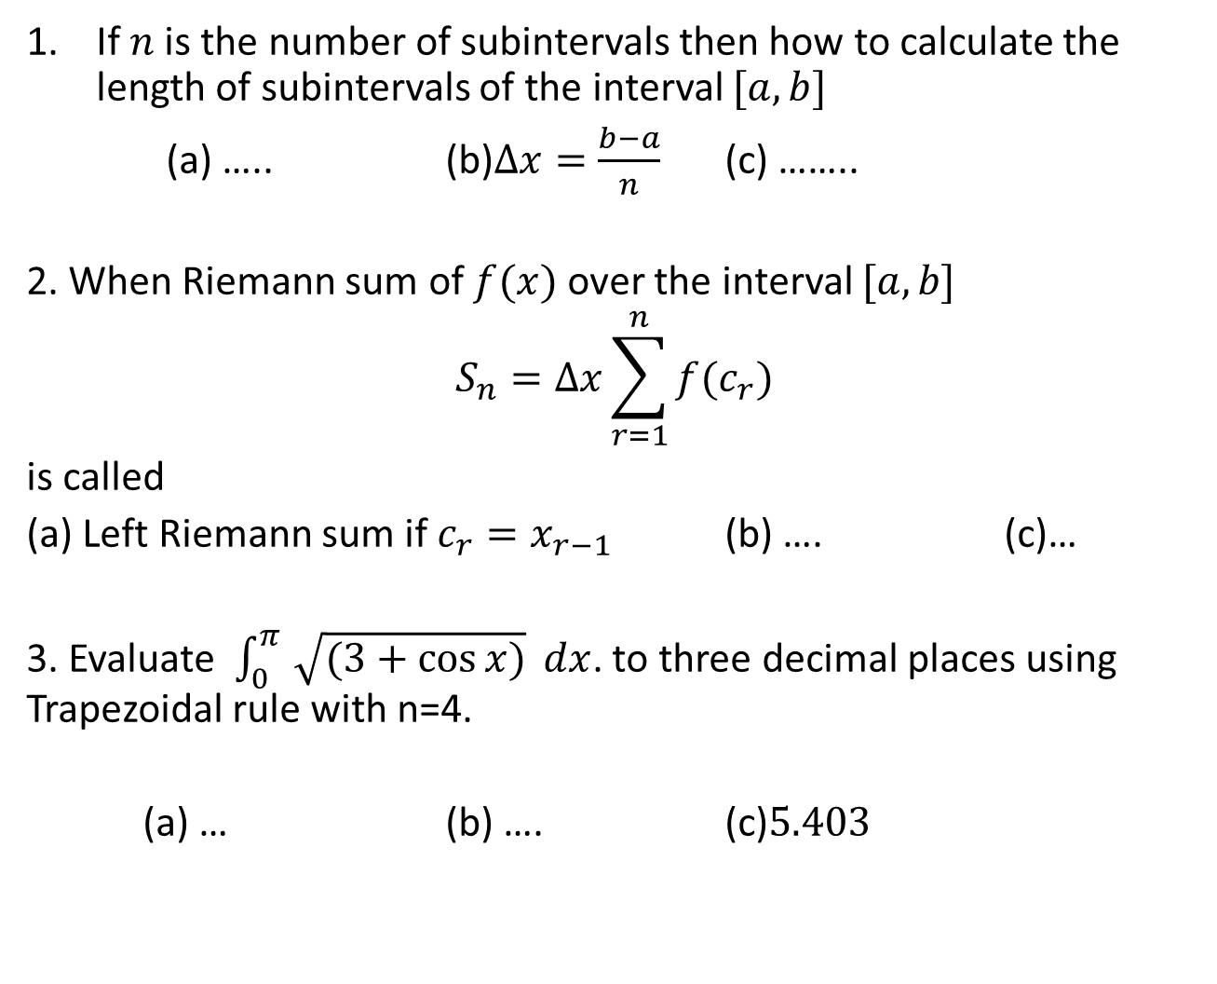
Sample MCQ
If $n$ is the number of subintervals then how to calculate the length of subintervals of the interval $[a,b]$
(a) ….. (b)$∆x=\frac{b−a}{n}$ (c) ……..
2. When Riemann sum of $f(x)$ over the interval $[a,b]$
$$S_{n}=∆x\sum_{r=1}^{n}{f(c_{r})}$$
is called
(a) Left Riemann sum if $c_{r}=x_{r−1}$ (b) …. (c)…
3. Evaluate $\int_{0}^{π }{\sqrt{(3+\cos{x)}}} dx$. to three decimal places using Trapezoidal rule with n=4.
(a) … (b) …. (c)$5.403$

Slide 37

1.2.3 The Fundamental Theorem of Calculus
Theorem: If $f\left(x\right)$ is a continuous function on $[a,b]$ and $f\left(x\right)$ is an indefinite integral of $f\left(x\right)$ then
where $∫f\left(x\right)dx=F(x)$.
Example:
1.
2.
3.

Slide 38
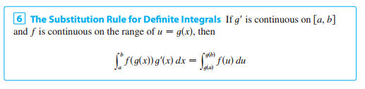
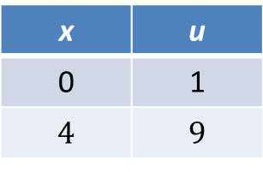
1.2.4 Substitution Rule For Definite Integrals
Example:
Changing Limit
x | u
0 | 1
$$4$$ | $$9$$

Slide 39
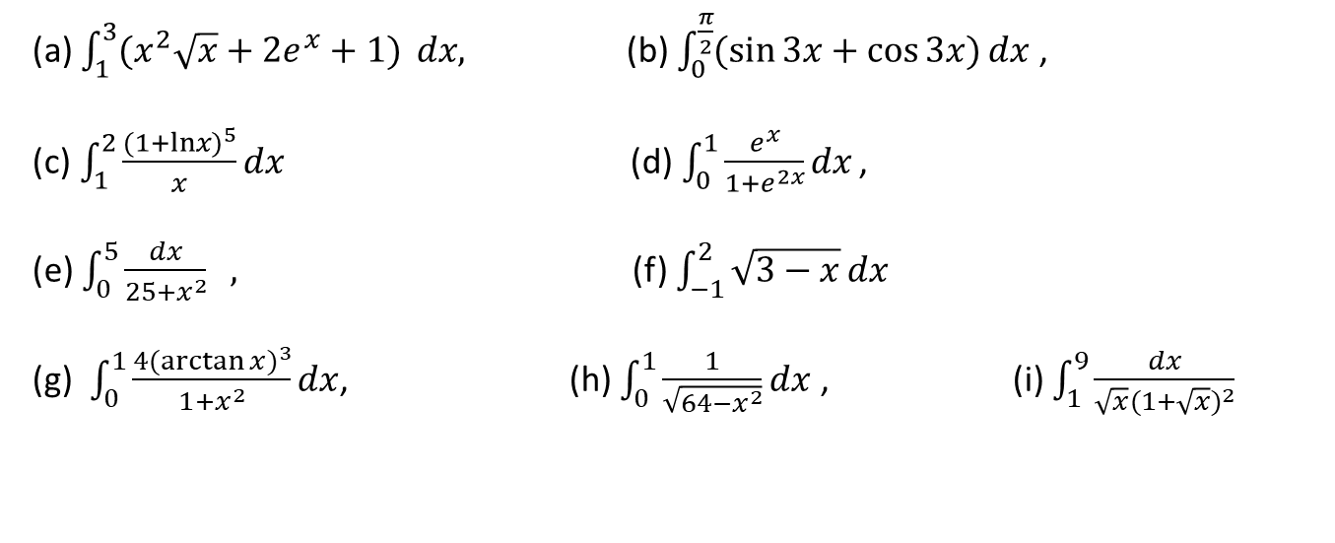
Exercise set 1.2.2
1.
(a) $\int_{1}^{3}{(x^{2}\sqrt{x}+{2e}^{x}+1)} dx,$ (b) $\int_{0}^{\frac{π}{2}}{(\sin{3x}+\cos{3x})}dx$,
(c)$\int_{1}^{2}{\frac{{(1+lnx)}^{5}}{x}}dx$(d)$\int_{0}^{1}{\frac{e^{x}}{1+e^{2x}}}dx$ ,
(e) $\int_{0}^{5}{\frac{dx}{25+x^{2}} } ,$ (f) $\int_{−1}^{2}{\sqrt{3−x}}dx$
(g) $\int_{0}^{1}{\frac{4{(\arctan{x})}^{3}}{1+x^{2}}dx}$, (h) $\int_{0}^{1}{\frac{1}{\sqrt{64−x^{2}}}dx}$ , (i) $\int_{1}^{9}{\frac{dx}{\sqrt{x}{(1+\sqrt{x})}^{2}}}$
2.
Calculus– James Stewart - 8th edition
P-400 Ex # 19, 23, 24, 25, 27, 29, 35, 43
P-409 Ex # 21 – 30
P- 419 Ex # 53, 54, 55, 59, 60, 70, 71

Slide 40
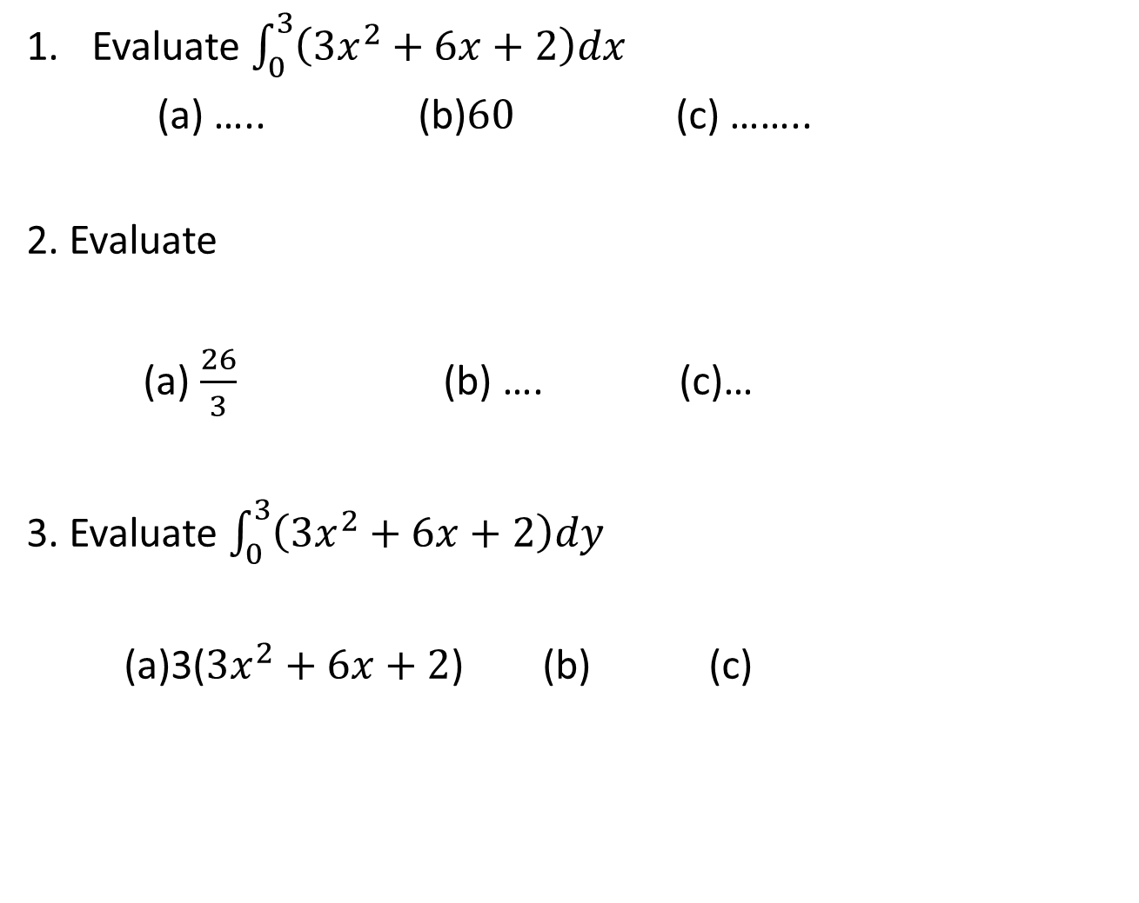
Sample MCQ
Evaluate $\int_{0}^{3}{\left(3x^{2}+6x+2\right)dx}$
(a) ….. (b)$60$ (c) ……..
2. Evaluate
(a) $\frac{26}{3}$ (b) …. (c)…
3. Evaluate $\int_{0}^{3}{\left(3x^{2}+6x+2\right)dy}$
(a)3($3x^{2}+6x+2$) (b) (c)

Slide 41
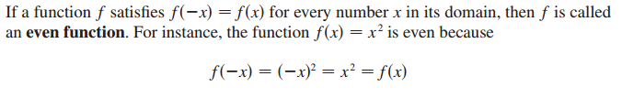

1.2.5 Even and Odd Function

Slide 42
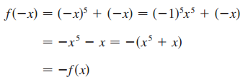


Example:
State whether the following functions are odd, even or neither.
Solution:
(a)
So, f(x) is an odd function
(b)
So, g(x) is an even function
(c)
So, h(x) is neither even nor odd function

Slide 43
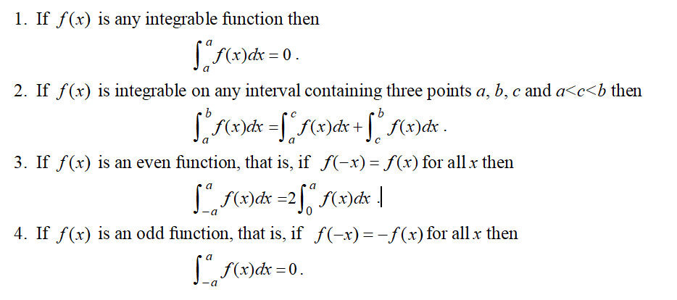
1.2.6 Some properties of definite integral

Slide 44
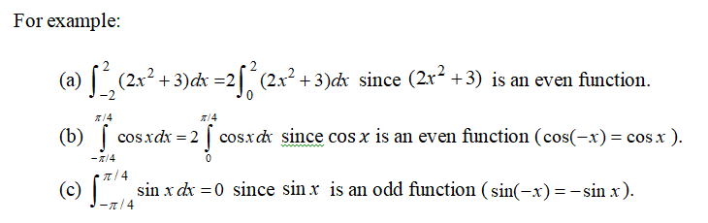

Slide 45


Exercise set 1.2.3
1.
State whether the following functions are odd, even or neither.
(a) $f\left(x\right)=x+x^{3}$, (b)$f\left(x\right)={(x^{2}+25) }^{2}$, (c)$f\left(x\right)=x^{6}+e^{4x}$,
(d)$f\left(x\right)=\sin^{3}x\cos^{6}x$, (e)$f\left(x\right)=\sin^{4}x\cos^{5}x$, (f) $f\left(x\right)=tanx+cotx$
2.
Evaluate the following integrals by using integral properties
(a) $\int_{−1}^{1}{\left(x^{3}+{5x}^{4}\right)dx}$, (b) $\int_{−2}^{2}{x\left(1+x+x^{2}\right) dx}$(c) $\int_{−4}^{4}{(2+{3x}^{2})}dx$,
(d)$\int_{−5}^{5}{x^{5}e^{x^{4}}dx}$, (e)$\int_{−π}^{π}{x^{8}sinx}dx$, (f)$\int_{−π}^{π}{x\cos{x dx}}$ ,
(g)$\int_{−π}^{π}{\sin^{3}x \cos^{5}x} dx$, (h)$\int_{−π/2}^{π/2}{x^{4}}\sin^{3}x \cos^{3}x dx$, (i) $\int_{−π}^{π}{\frac{x^{3}}{\sqrt{1+x^{2}}} dx}$,
3.
Calculus– James Stewart - 8th edition
P- 419 Ex # 61, 66, P-422 Ex # 22, 23

Slide 46

Sample MCQ
Which one is even function
(a) ….. (b)$f\left(x\right)=x^{4}+x^{2}$ (c) ……..
2. Which one is odd function
(a) $f\left(x\right)=sin2x$ (b) …. (c)…
3. Evaluate $\int_{−3}^{3}{\left(sin2y\right)dy}$
(a) 0 (b) (c)

